Slide 1
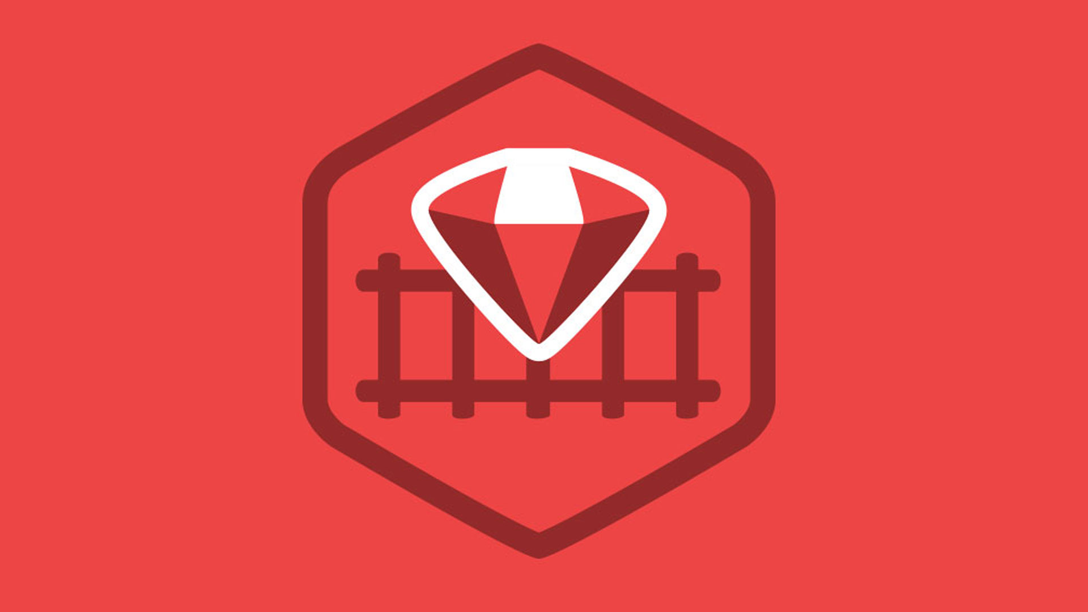
Ruby on Rails

Slide 2
About today…
React.js with RoR
Creating API in RoR
Consuming API in React.js
BENEFIT
Clear separation of concerns, independent scalability, and potential for reuse across different platforms

Slide 3

Creating an API in RoR
Consuming API in React.js

Slide 4
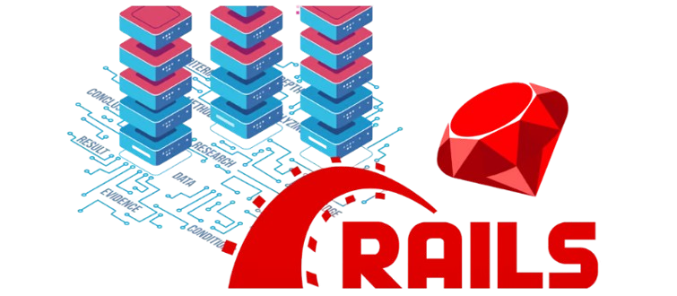
Setting Up RoR API
Install Rails
gem install rails
Create Rails App
rails new task_api --api
Navigate to Directory
cd task_api
Start Server
rails server
Install Gems
Add gem 'rack-cors' and gem 'active_model_serializers' to Gemfile, then run
bundle install

Slide 5
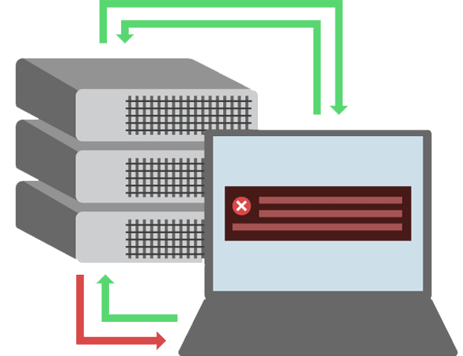
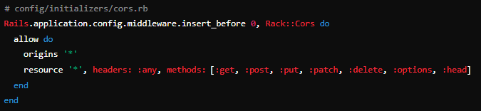
Configuring CORS
( Cross-origin resource sharing )
Enable CORS
A mechanism for integrating applications.
Defines a way for client web applications that are loaded in one domain to interact with resources in a different domain

Slide 6
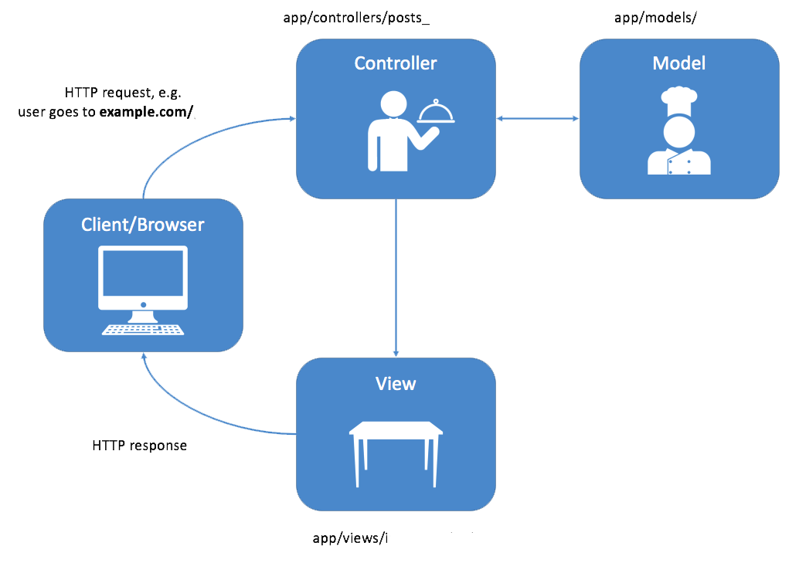
Creating Models and Controllers
Generate Model
rails generate model Task title:string description:text
Migrate Database
rails db:migrate
Generate Controller
rails generate controller Tasks

Slide 7
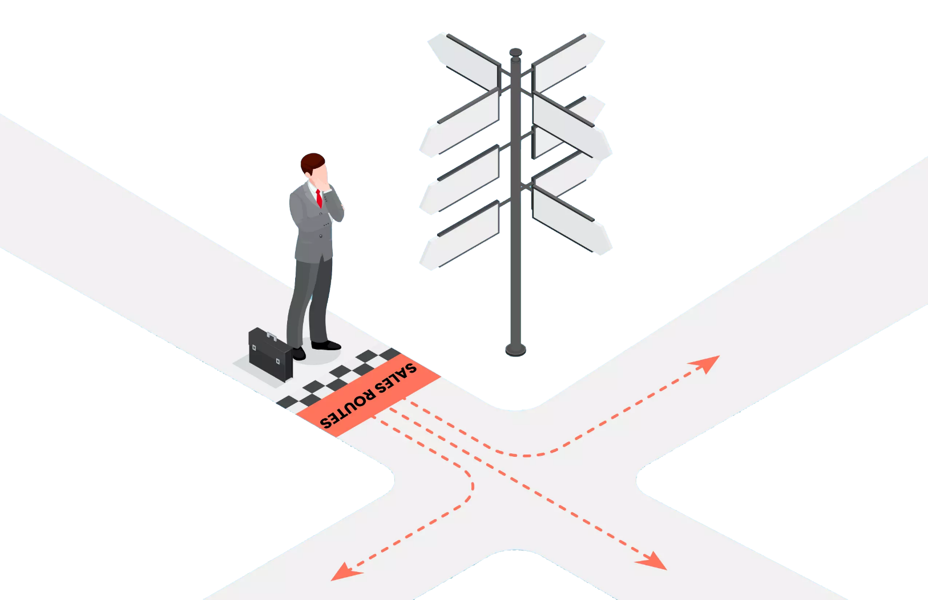
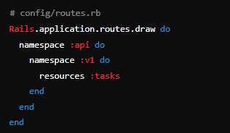
Defining Routes
Routes

Slide 8
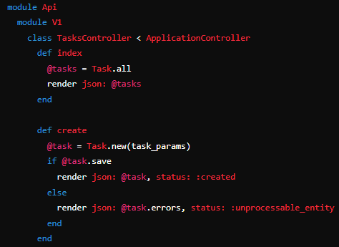
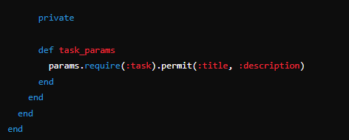
Creating Controllers
Controller Actions

Slide 9
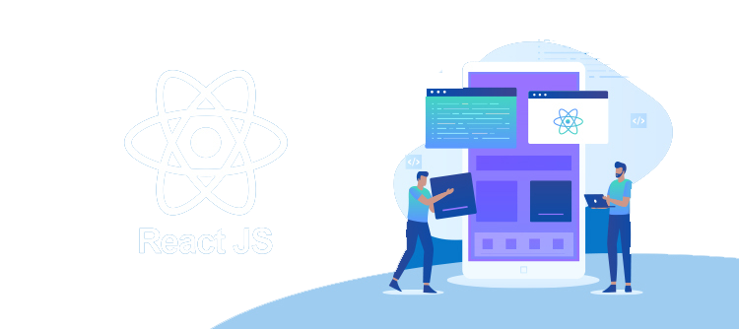
Setting Up React.js Frontend
Create React App
npx create-react-app task_frontend
Navigate to Directory
cd task_frontend
Start React App
npm start

Slide 10
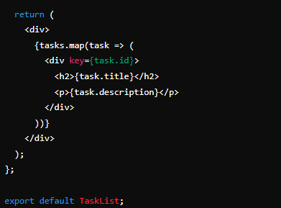
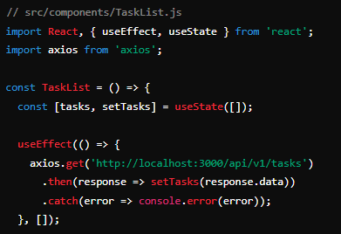
Fetching Data from RoR API in React
Install Axios
npm install axios
Fetch Data

Slide 11


Slide 12

What command is used to install Rails?
gem install rails
Which method is used in React to fetch data from an API?
axios.get
How do you create a new React app named 'task_frontend'?
npx create-react-app task_frontend
Which gem is added to handle CORS in the Rails API?
rack-cors

